Slide 1
Presentation-1 on Chosen Advanced ML Technique Advanced Machine Learning ITI41820

Slide 2
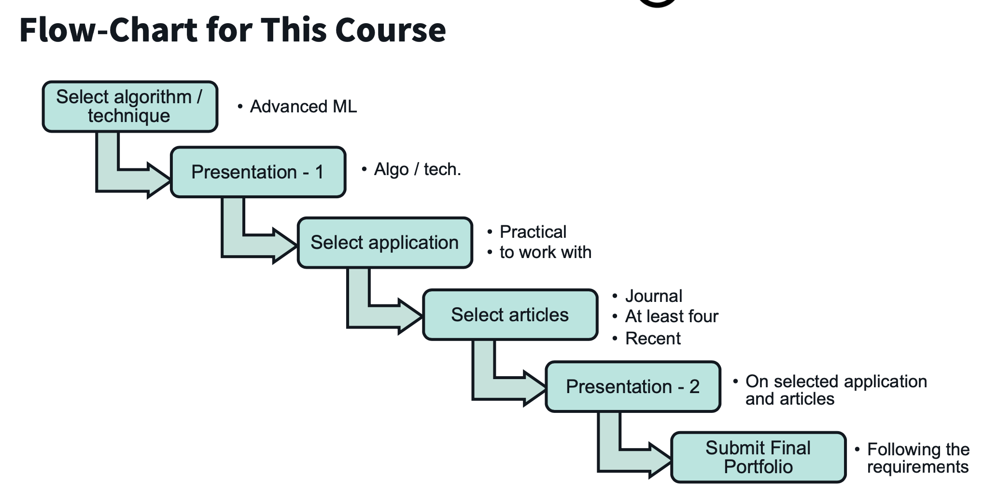
Where are we...
Source: Lecture 1 slides

Slide 3
Presentation 1 Contents
What is this technique/algorithm?
Why is it special?
How is it different from other similar techniques
Some practical examples
Woking principle
Working flow, equations, analysis
Advantages and Disadvantages
It’s probable (practical) applications, with the justification of why your chosen technique/algorithm is particularly suitable for this type of application(s) than that of similar existing ML technique(s)/algorithm(s).

Slide 4
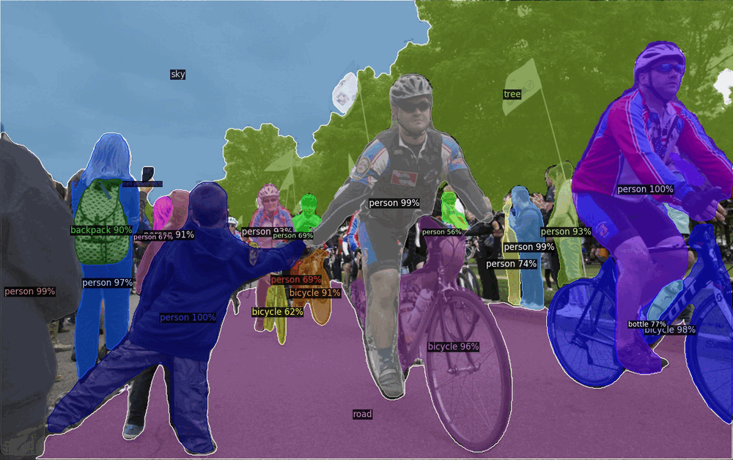
What is Object Detection? Simply put – Classification and Localisation!
For any object detection task
Object Proposals
Classification
Localisation
Source: Facebook/Meta AI
Notes:
Object detection is a computer vision task that involves identifying and locating objects within an image or video. The goal of object detection is to detect the presence of objects in an image or video, and to determine their location and extent. Object detection involves three main tasks: Object proposals, object classification and object localization. Object proposals is the algorithm generates a set of candidate regions that may contain objects. These regions are typically defined by a bounding box that encloses the area of interest. Object classification involves assigning a label to each object, such as "car," "person," or "dog." Object localization involves identifying the location and size of each object within the image or video. Object detection is a challenging task because objects can appear in different sizes, shapes, and orientations, and can be partially occluded or obscured by other objects in the scene. To address these challenges, object detection algorithms typically use a combination of image processing techniques, machine learning algorithms, and deep neural networks to detect and localize objects in images or videos.

Slide 5
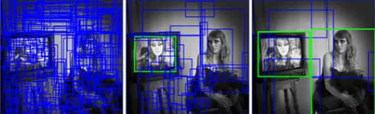

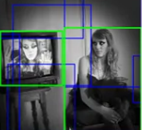
1. What is this technique / algorithm?
Chosen Technique / Algorithm : One-Stage Object Detection using EfficientDet algorithm.
TSOD
TSOD | OSOD
RCNN | YOLO
Fast RCNN | SSD
Faster RCNN | EfficientDet
OSOD
Lecture 15: Object Detection: Michigan Online
Notes:
The core difference between TSOD and OSOD is that TSOD are very strict in terms of region proposals where a bi-level networks exist which first proposes the region which is likely to have objects and then classify then localise those regions. However, OSODs are much more faster and efficient because they completely skip first stage of region proposals. However, there is a tradeoff of accuracy vs speed. My chosen technique is OSOD and algorithm is EfficientDet algorithm.

Slide 6
2. Why EfficientDet special?
Launched in 2020 with code release in 2021 – scope of research and novel contributions.
High accuracy on benchmark dataset (73.5%) - reportedly much efficient (Inference time 12.3ms) than YOLO and other SOTA algorithms [M.Tan et al. CVPR 2020].
Balances the popular OD tradeoff (speed vs accuracy)
Works on legacy OSOD
Backbone – EfficientNet (Also, Modular Architecture with flexiblity to change Backbne)
Neck – BiFPN (Bilateral Fusion Pyramid Network)
Head – Multiple convolution and FC layers

Slide 7
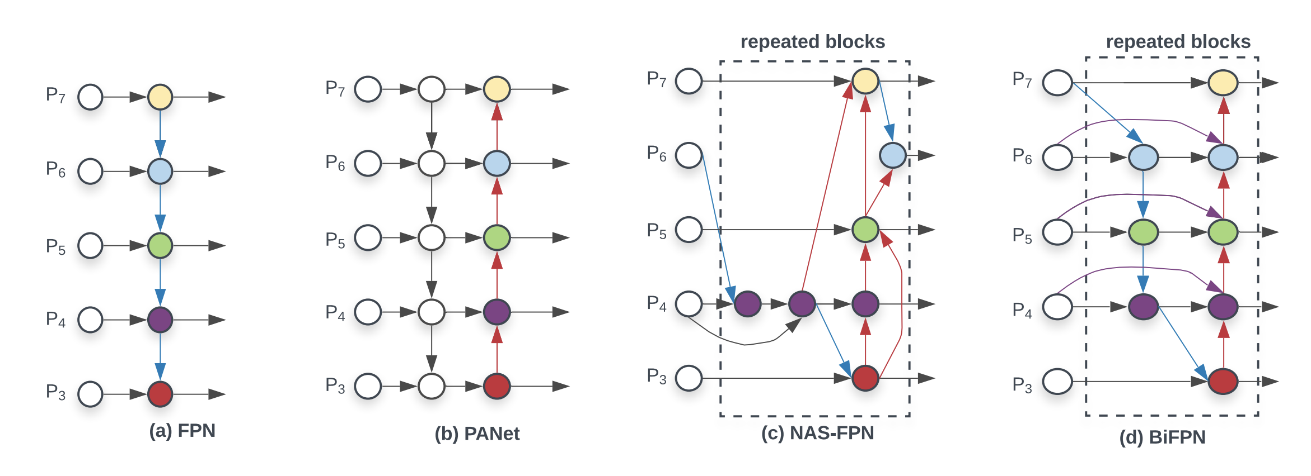
3.1 How is it different from other similar techniques
BiFPN - Bilateral Fusion Pyramid Network
Tan, M., Pang, R., & Le, Q. V. (2020). Efficientdet: Scalable and efficient object detection. In Proceedings of the IEEE/CVF conference on computer vision and pattern recognition (pp. 10781-10790).
Used in EfficientDet
Used in YOLOv5
Used in SSD
Used in Retinanet

Slide 8
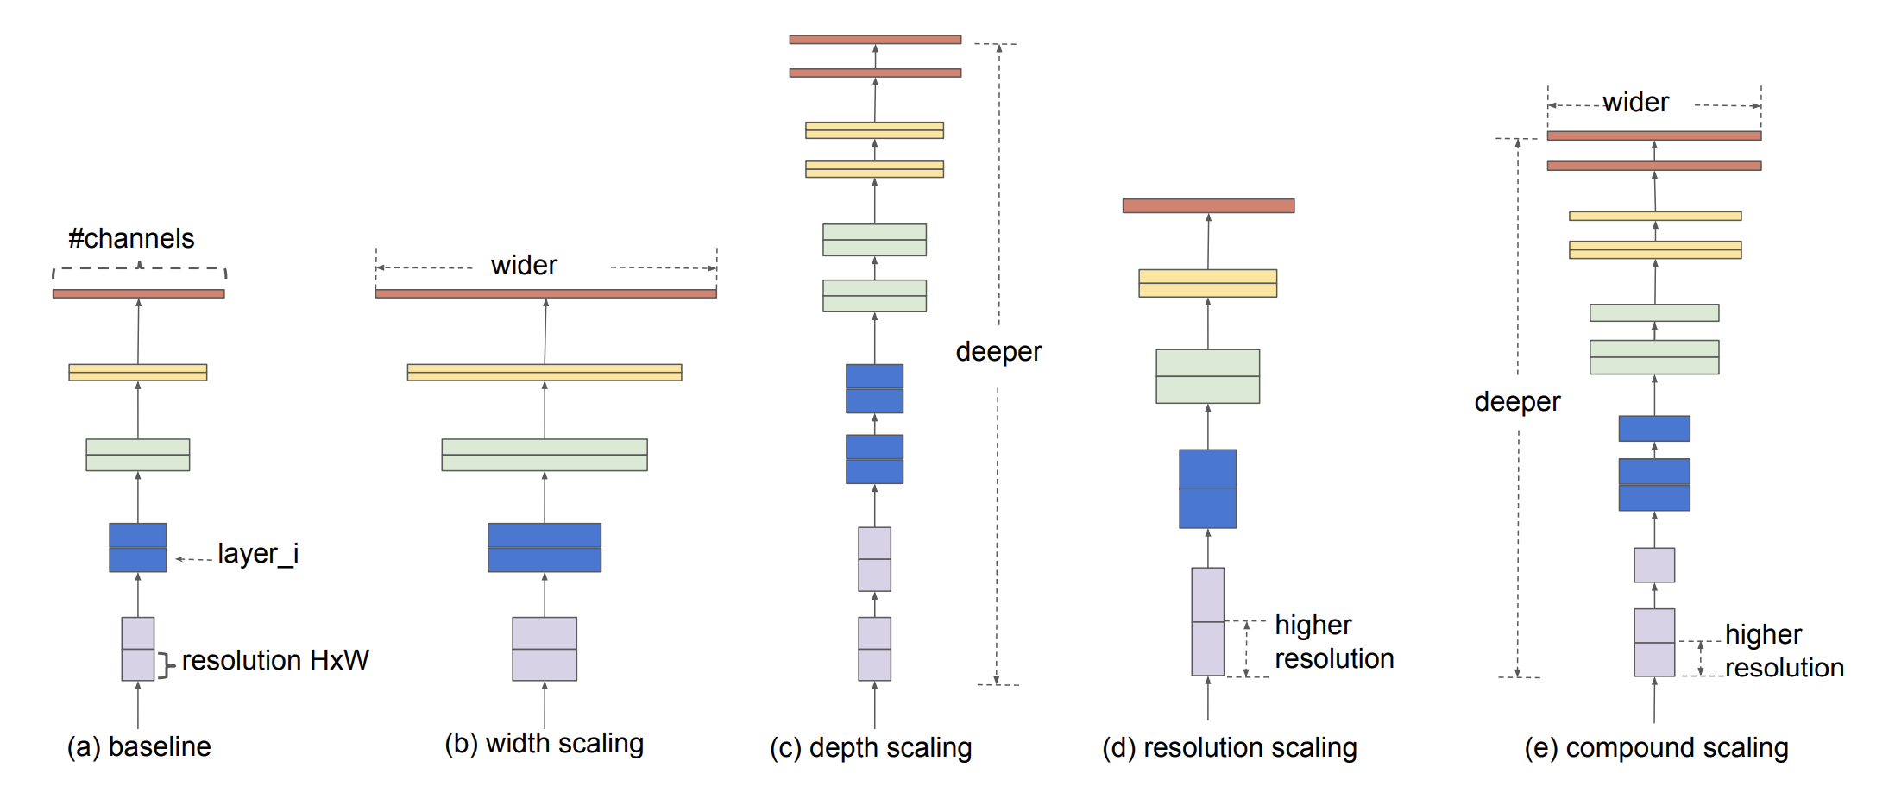
3.2 How is it different from other similar techniques
Compound Scaling method for Uniform Scaling
Tan, M., & Le, Q. (2019, May). Efficientnet: Rethinking model scaling for convolutional neural networks. In International conference on machine learning (pp. 6105-6114). PMLR.
+
=

Slide 9
3.3 Practical Example
Widely used in real time edge computing with high time constraints
EfficientDet for fabric defect detection based on edge computing (2021, S. Song et al)
EfficientDet for Crop Circle Detection in Desert (M.L.Mekhalfi et al 2022)
Drivers Fatigue Detection using EfficientDet (R. Ayachi et al 2021)
Automatic Helmet Detection (M.T. Ubaid 2021)

Slide 10
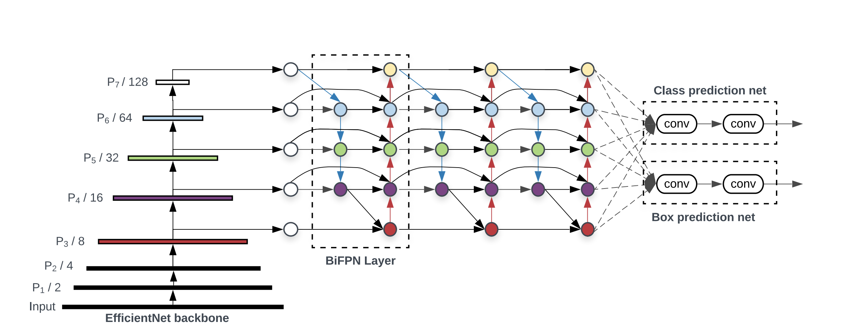
4.1 Working Principle
EfficientDet Architecture
Tan, M., Pang, R., & Le, Q. V. (2020). Efficientdet: Scalable and efficient object detection. In Proceedings of the IEEE/CVF conference on computer vision and pattern recognition (pp. 10781-10790).
Backbone
Head
Neck

Slide 11
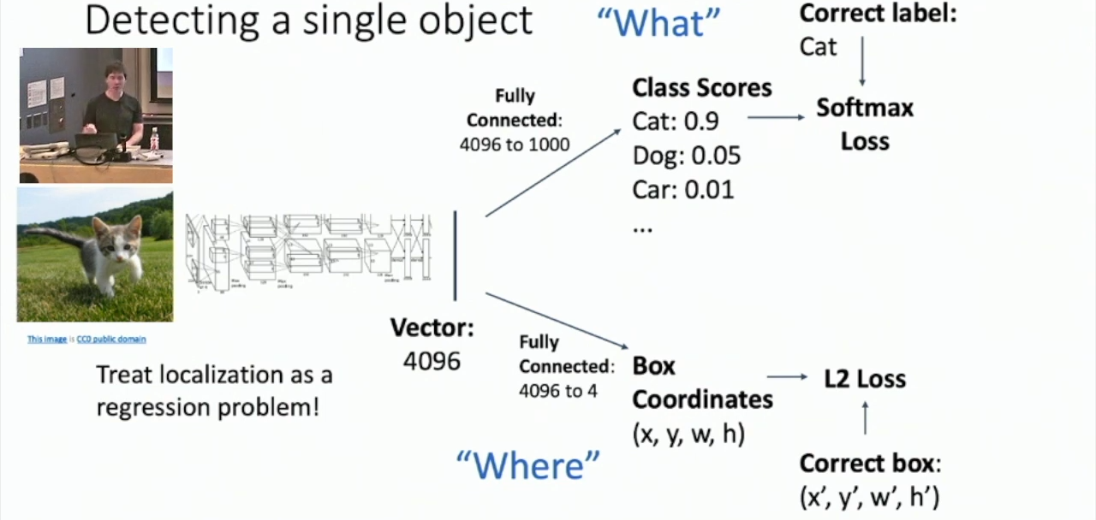
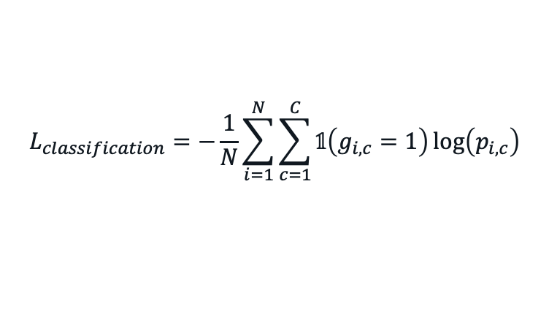
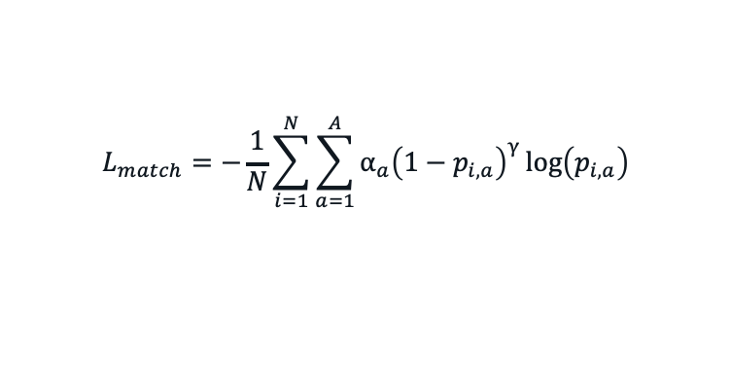
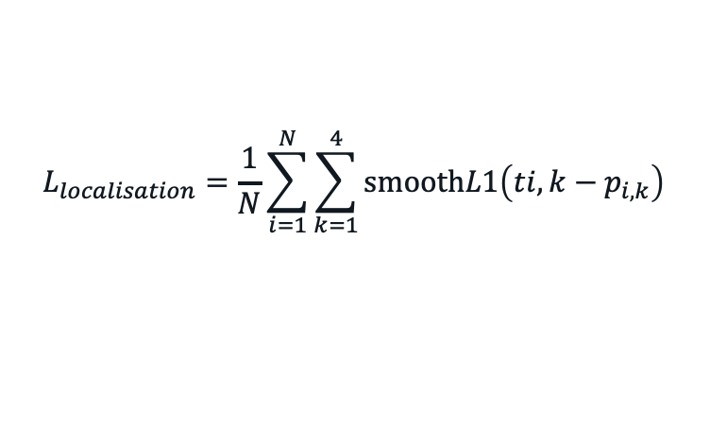
4.2 Working Principle
Loss Functions
Classification Loss
Localisation Loss
Anchor Matching Loss
$$L_{classification}=−\frac{1}{N}\sum_{i=1}^{N}{\sum_{c=1}^{C}{𝟙\left(g_{i,c}=1\right)\log\left(p_{i,c}\right)}}$$
$$L_{localisation}=\frac{1}{N}\sum_{i=1}^{N}{\sum_{k=1}^{4}{\text{smooth}L1\left(ti,k−p_{i,k}\right)}}$$
$$L_{match}=−\frac{1}{N}\sum_{i=1}^{N}{\sum_{a=1}^{A}{α_{a}{\left(1−p_{i,a}\right)}^{γ}}\log\left(p_{i,a}\right)}$$

Slide 12
5. Advantages and Disadvantages
Advanatages
Super efficient and Accurate among other OSOD
Less number of parameters compared to other OSOD
Simple Architecture
Disadvantages
Large memory requirement
Train time
Fine tuning
Lack of Interpretability

Slide 13
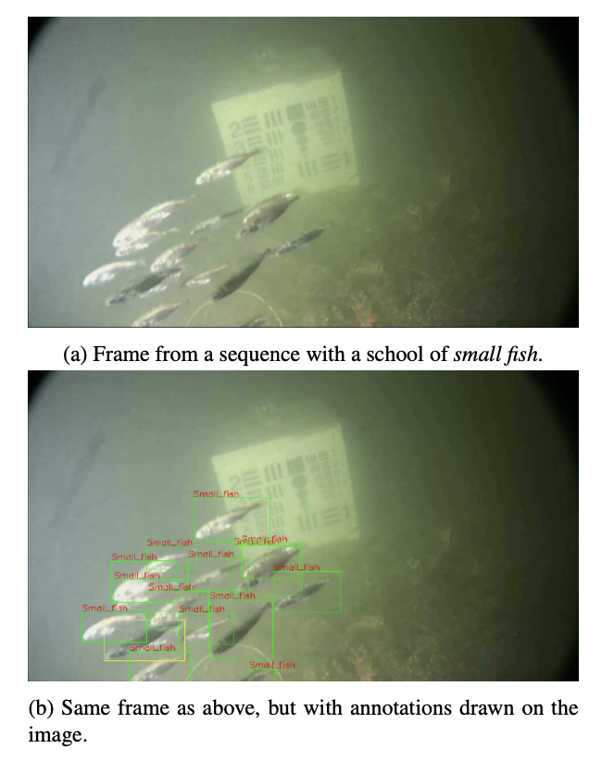
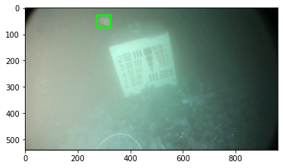
6.1 Probable Practical Application
Detection of underwater martime objects (Brackish Dataset AALBORG University) – Cross Domain Modalities
Source of Dataset: Pedersen, M., Bruslund Haurum, J., Gade, R., & Moeslund, T. B. (2019). Detection of marine animals in a new underwater dataset with varying visibility. In Proceedings of the IEEE/CVF Conference on Computer Vision and Pattern Recognition Workshops (pp. 18-26).

Slide 14
6.2 Why EfficientDet for this application than other OSOD like YOLO, SSD, RetinaNet
EfficientDet has reportedly proven to work best on
Complex task domains where objects are relatively difficult to identify because of the nature of task.
For example – Crop Detection, Adulteration detection in grains, Defect detection in fabric factory, Efficient site detection for solar power etc.
Most of the researchers has considered YOLO framework because of its fast-to-implement, however, for such complex tasks, EfficientDet is expected to give SOTA accuracy on such tasks. One of such tasks, that I plan to chose is “Detection of underwater martime objects”

Slide 15
Planned Novel Contributions
EfficientDet has less interpretability.
To make it more Interpretable.
Make it robust for adversarial attacks.

Slide 16

Thank You! Questions? References:

